Slide 1












Location Based Context Aware Route Planner
Instructor: Dr. Isam Al Jawarneh
Eisa Sajwani – U23200051
Eisa Alsaadi – U22200231
Usama Habib – U23102906
1

Slide 2


Outline
Introduction & Data Description
Route Planning Algorithms
Air Quality Monitoring
Methodology
Linear Weighting Method
Evaluation
Future Directions
Conclusion
2

Slide 3





Introduction
Importance of route planning:
Essential for various application like logistics and navigation
Finding the optimal path between locations
Algorithms used :
Dijkstra's algorithm
Bellman-Ford algorithm
Air quality monitoring integration:
Critical for environmental health assessments
Utilize PM10 and PM2.5 to measure air quality and provide healthier routes
Linear weighting method
Combines multiple factors to evaluate routes
Allows balanced consideration for different travel conditions
Objective : Develop a system that integrates these elements to provide optimal and healthy route options for urban commuters
Notes:
Urban Mobility Challenges:
Congestion: Cities worldwide face increasing traffic congestion due to population growth, urbanization, and inadequate transportation infrastructure. Congested roads lead to longer travel times, increased stress, and economic losses.
Air Pollution: Urban areas suffer from poor air quality due to vehicle emissions, industrial activities, and construction. Air pollution adversely affects public health, leading to respiratory diseases and other health issues.
Noise Pollution: High traffic volumes contribute to noise pollution, impacting residents’ well-being and quality of life.
Limited Space: Urban environments have limited space for expanding road networks, necessitating innovative solutions for efficient transportation.
Importance of Integrating Air Quality in Route Planning:
Health Impact: Poor air quality directly affects human health. Integrating air quality data into route planning can help minimize exposure to pollutants during travel.
Environmental Concerns: Reducing emissions from vehicles contributes to environmental sustainability. By choosing cleaner routes, we can mitigate the impact of transportation on the ecosystem.
Efficiency: Optimal route planning considers both travel time and air quality. Avoiding heavily polluted areas can lead to faster and healthier journeys.
Public Awareness: Incorporating air quality information into navigation apps raises public awareness about pollution levels and encourages eco-friendly choices.
In summary, addressing urban mobility challenges requires a holistic approach that considers air quality alongside efficient route planning

Slide 4




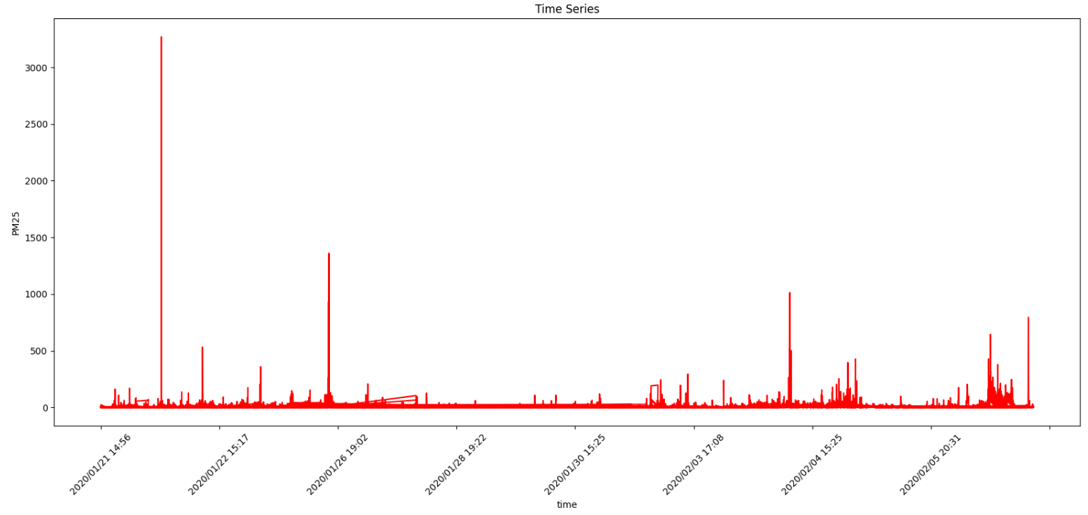
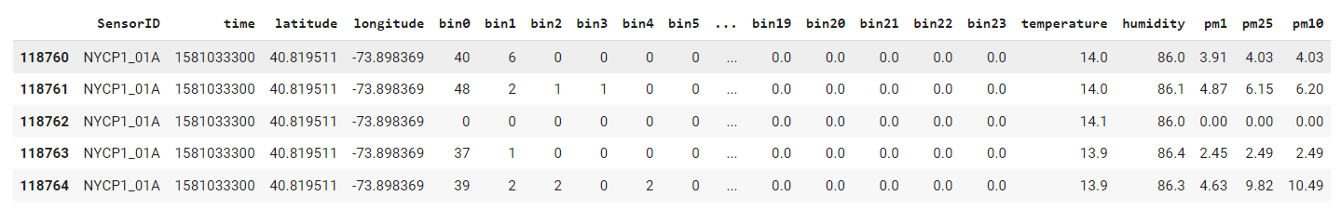
Data Description
118764 Rows of data
Time, Latitude, Longitude, Temprature , Humidity, Particulate Matter (PM)
Collected by low-cost AQ sensors on 21/1/2020 14:56
4

Slide 5



Route Planning Algorithms.
Dijkstra’s Algorithm
Finds the shortest path between two nodes in a graph.
Simple to understand and implement.
Guarantees the shortest path.
Inefficient for large graphs.
Doesn’t handle negative edge weights.
Used in network routing and GPS navigation.
01
Bellman-Ford Algorithm
Computes shortest paths from a single source vertex to all other vertices in a weighted digraph.
Handles negative edge weights.
Detects negative cycles.
Applications: network routing, transportation systems, and financial modeling.
02

Slide 6

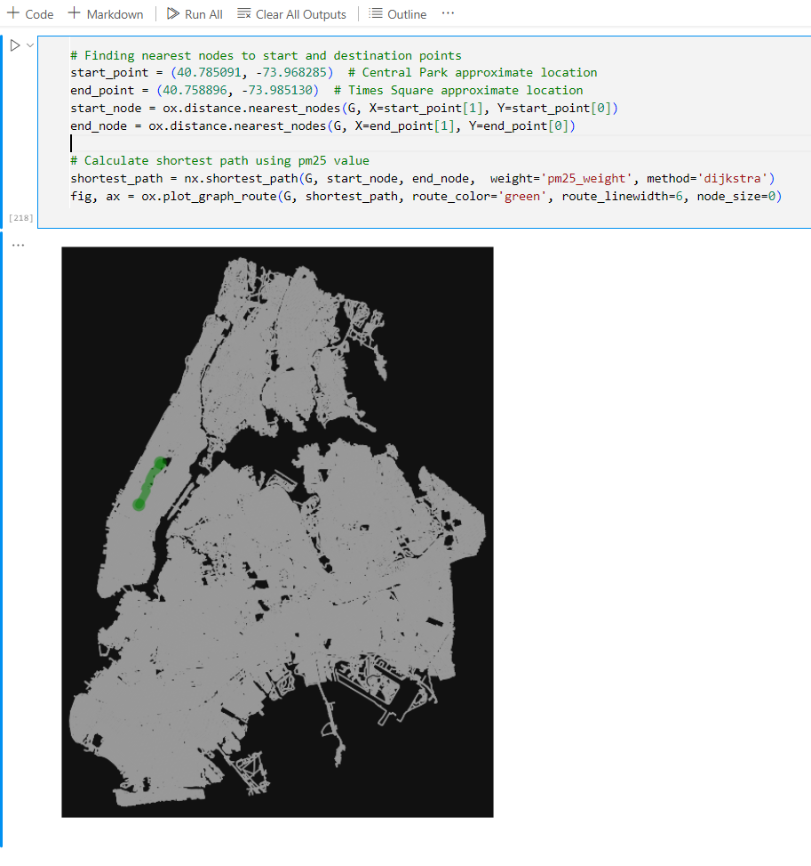
Air Quality Monitoring
Role of PM10 and PM2.5 Sensors in Environmental Health:
PM10 and PM2.5 sensors measure airborne particles.
They provide real-time air quality data.
World Health Organization (WHO) sets guidelines for PM Concentrations
Below 10 µg/m³ annually for PM2.5
Below 20 µg/m³ annually for PM10
How Air Quality Data Enhances Route Recommendations:
Dynamic routing based on air quality.
Eco-friendly routes to reduce emissions.
Health-conscious navigation.
Integration with public transport.
Benefits smart cities.
6

Slide 7


















Methodology
1
Task 1: Data Exploration & Initial Route Planning
2
Task 2: More Deep Data Exploration Techniques
Territorial
Personal
Informational
Privacy
Privacy
Privacy
3
Task 3: Evaluating Route Recommendations with Stratified Sampling
Privacy Dimensions
4 Task 4: Route Planning using Taxi Mobility Data
5
Task 5: Report Writing (Research Paper)
7

Slide 8
Task 1
Data Exploration Techniques such as min, max, time series graphs, point maps and clustering.
Extracted street network data using geo-pandas and performed spatial join with PM data.
Approach 1: Shortest Route Recommendation based on PM 2.5 values as edge weight in network.
Approach 2: Shortest Route Recommendation based on Mean of PM 2.5 for each street segment.

Slide 9
Task 2
Performed more data exploration techniques like, histogram plots using different parameters & handling missing values.
Removing outliers from columns such as PM10 PM2.5, using mean value, standard deviation & threshold by analyzing through histograms.
After removing outliers, finding shortest path using PM2.5 column as edge weight, similarly for temperature and humidity also.

Slide 10
Task 3
Assigning edge weight, with a combined value of air quality data and mobility (no of cars) using Linear Weighting Method.
Finding shortest path based on these edge weights also calculating time.
Calculate Geohash(string) based on latitude and longitude for each data point.
For each geohash group, fraction of data is selected based on sampling fraction = 0.1.
Finding shortest path from stratified sampled data also calculating time.
Calculating trajectory similarity measures (Euclidean Distance) for different sampled fractions.

Slide 11
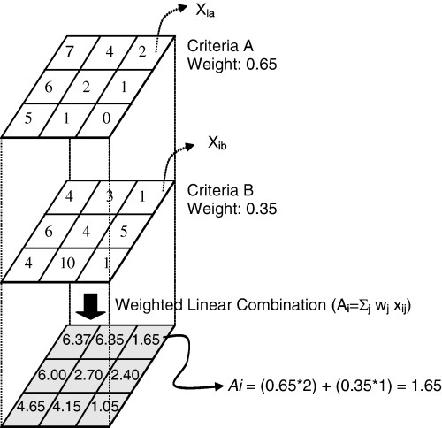
Linear Weighting Method
It is used to add more than 1 elements within the network, assigning ratings & scores to each element & combining them.
r ̂_uiqm= p (v_i= r_q ).r ̂_uiq+(1- p (v_i= r_q )).r ̂_uim
r̂_uim: This is the predicted rating for neighboring mobility density.
r̂_uiq: This is the rating of air quality for the same item.
p(v_i = r_q): This term represents the probability that user 𝑢 has rated item 𝑖 with rating 𝑟 in air quality condition 𝑞 (pm value).

Slide 12
Task 4
Assigning weights to the graph edges using Taxi Mobility data.
Recommending Shortest Path based on that.
Also Computing the time and visualizing the route.
Task 5
Report Writing (Research Paper)

Slide 13
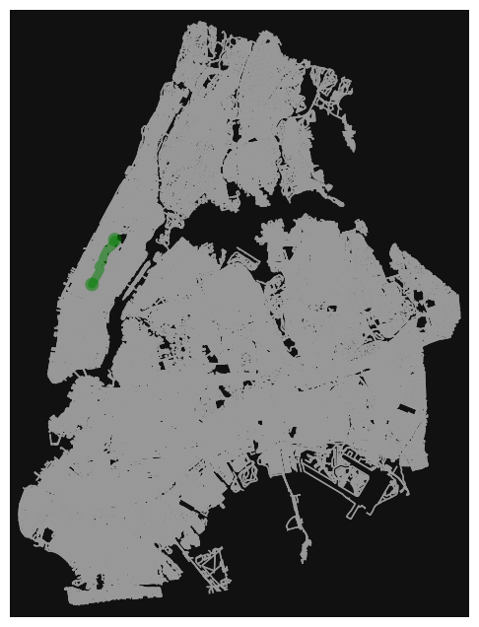
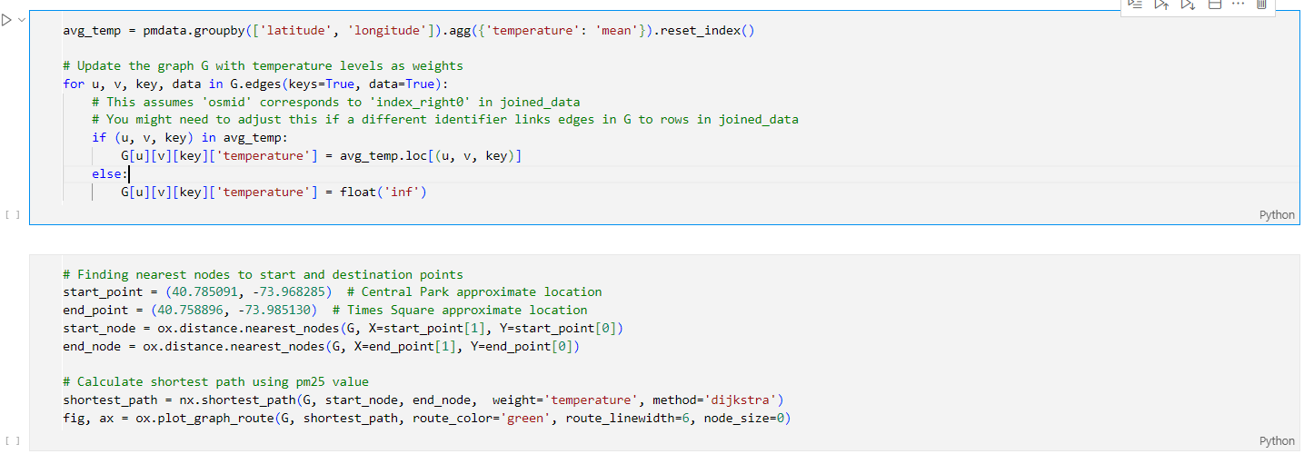
Evaluation
Dijkstra’s Algorithm: Using one variable, temperature
13

Slide 14
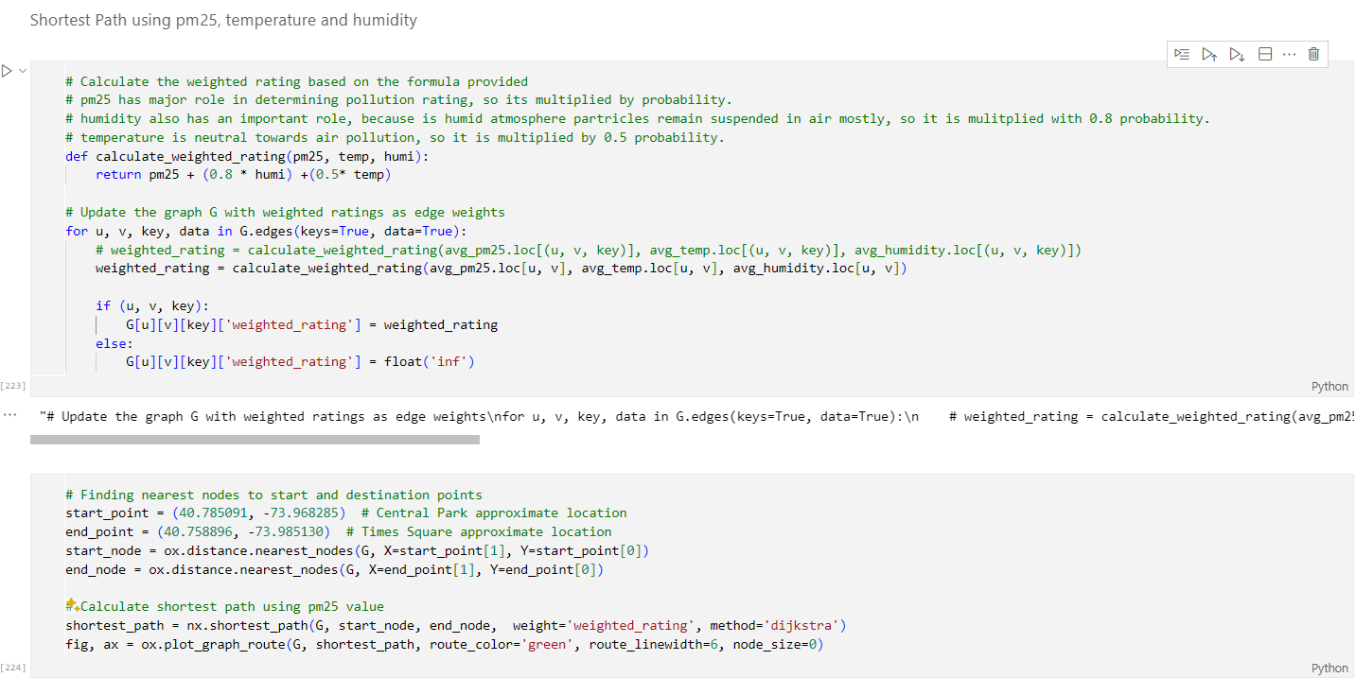
Evaluation
Dijkstra’s Algorithm: Linear weighting method. Using 3 different variables, pm, temperature and humidity
14

Slide 15
Future Work
Future Work
› Apply the system to different datasets, like NYC taxi mobility data, for broader evaluation.
› Incorporate additional factors such as traffic congestion and elevation changes into the weighting scheme.
› Explore advanced metrics like PM2.5 dose reduction rate to quantify health benefits.
› Develop a user-friendly interface to make the system accessible to a wider audience.

Slide 16
Conclusion
Conclusion
› The project developed a route planning system integrating air quality data (PM2.5) into pathfinding.
› The system recommends routes minimizing pollution exposure while considering distance.
› Evaluation using stratified sampling showed the system’s accuracy in providing route recommendations.

Slide 17

Thank You
Any questions?

